Slide 1

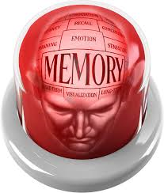
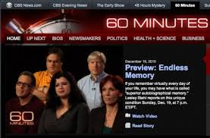
Topic: Memory
Aim: In what ways does the complexity of memory function?
Do Now: How do you study for tests? Describe how you remember information you learned in school?

Slide 2
How would you define a person’s “Memory”?
Why does the human brain have the capacity to remember?
How good or bad of a memory do you have? Why do you think this is?
Do you think your memory has gotten better or worse over time? What factors influenced this?
Do you have trouble remembering people’s names, faces, or both after meeting them? What influences this?
Do you ever have trouble remembering how to do certain tasks?

Slide 3
Memory Quiz - Volunteer please?
The last 3 movies you saw
The first movie you ever saw
What you had for dinner last Wednesday
What you had for dinner last night
The last test you failed
Why do you think you can remember some of these things and not others?

Slide 4

Memory: the storage and retrieval of what has been learned or experienced. Influenced by biological factors (hormones, brain function,etc) and emotional factors (stress, happiness, etc)
2 primary types: short-term and long-term

Slide 5
















Information Processing Model
1. Encoding
gone
2. Storage
Long Term Memory
3. Retrieval
All the rest
Retrieval
External Stimuli
Sensory Registers
Attention
Short Term Memory

Slide 6
How things are remembered:
Encoding
Encoding: the information gets into our brains in a way that allows it to be stored
Storage: the information is held in a way that allows it to later be retrieved
Retrieval: reactivating and recalling the information, producing it in a form similar to what was encoded
Storage
Retrieval
Notes:
Click to reveal bullets.

Slide 7
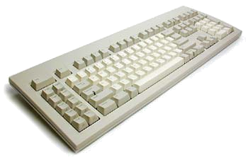
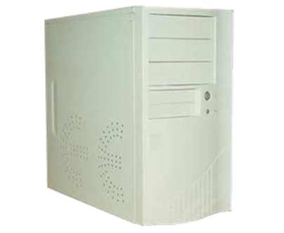
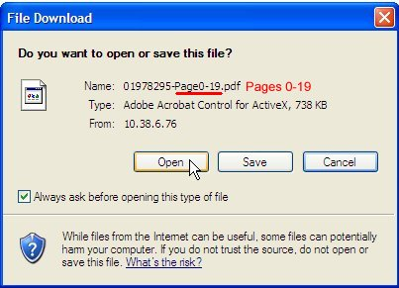
Processes Involved in Memory
Encoding:. Think of it like entering info through your keyboard
Storage: Think of it like saving data on computer.
3. Retrieval: Think of it as opening the file and displaying it on your monitor

Slide 8
Retrieval Cues
Deja Vu (French)--already seen
  cues from the current situation may subconsciously trigger retrieval of an earlier similar experience
  "I've experienced this before."
Mood-congruent Memory
  tendency to recall experiences that are consistent with one’s current mood
  memory, emotions, or moods serve as retrieval cues
  State-dependent Memory
    what is learned in one state (while one is high, drunk, or depressed) can more easily be remembered when in same state

Slide 9
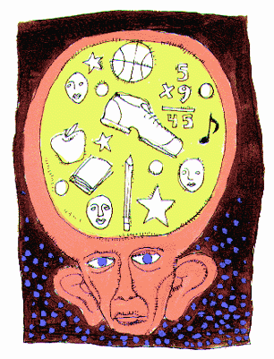
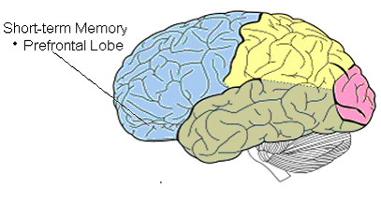
Short-Term Memory:
Temporary storage of information
Capacity is about 7 (+2) items in healthy adults. Lasts less than 20 seconds unless you use…
Maintenance Rehearsal: repeating information to oneself - short term memory game

Slide 10
1 minute to memorize the following…
Circle
Pilot
Tubing
Apple
Bread
Midnight
Sleigh
Map
Problem
Train

Slide 11


Attention Matters…
It acts like a filter that and allows you to select the most important things that enter into your conscience mind.

Slide 12
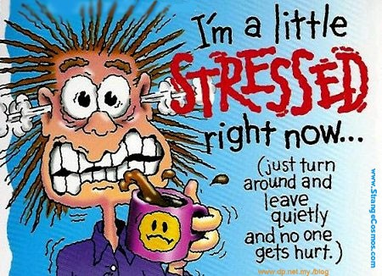
Stress, Hormones & Memory
Heightened emotions (stress-related or otherwise) make for stronger memories.
Hormones such as Epinephrine act on brain centers in the brain
Extreme stress undermines learning and later recall
Notes:
OBJECTIVE 12| Discuss some ways stress hormones can affect memory.

Slide 13
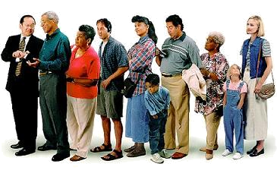
The “Next-in-Line” Effect:
If people in a small group take turns speaking to the group, memory tests reveal that people tend to not remember much of what was said by the person who spoke before them.
When people are “next-in-line,” they are too preoccupied with what they are going to say next.

Slide 14
Chunking:
The process of grouping items to make them easier to remember.
Chunking is part of the short-term memory and still lasts for about 20-30 seconds if not rehearsed.
9117114111800

Slide 15
Or…
911 (police/fire)
7-11 (the store)
411 (information)
1-800 (before certain phone numbers)

Slide 16
Remember the following:
Omgwtflollmaottylwthbtw

Slide 17
Easier to Remember???
OMG
WTF
LOL
LMAO
TTYL
WTH
BTW

Slide 20
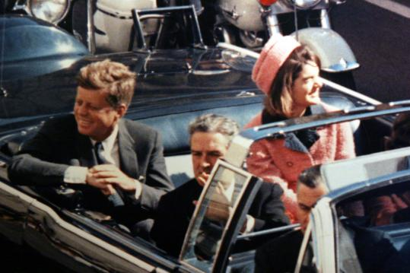
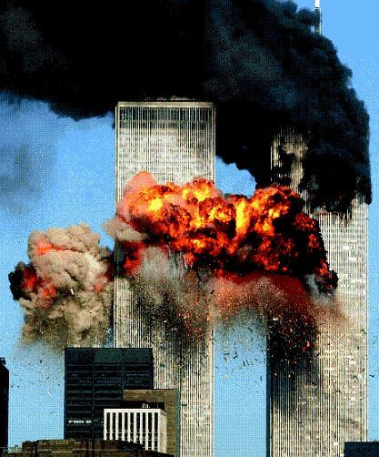
Flashbulb Memory:
Phenomenon that centers around a specific, important, or surprising event
Represents a ‘mental snapshot’
Can you think of any flashbulb memories in your own life? Good or bad.

Slide 21
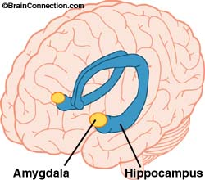
How does intense emotion cause the brain to form intense memories?
Emotions can trigger a rise in stress hormones.
These hormones trigger activity in the amygdala, located next to the memory-forming hippocampus.
The amygdala increases memory-forming activity and engages the frontal lobes and basal ganglia to “tag” the memories as important.
As a result, the memories are stored with more sensory and emotional details.
These details can trigger a rapid, unintended recall of the memory.
Traumatized people can have intrusive recall that is so vivid that it feels like re-experiencing the event.
Notes:
Click to reveal bullets.
Instructor: students may anticipate that the last bullet point refers to PTSD.
Note that these memories may feel as vivid as if we were re-experiencing the event, but they are not necessarily accurate; in fact, they get altered every time we recall them. This change can make the memory worse, or can be a good thing; trauma therapy depends on this “reconsolidation.”

Slide 22
MILK
CHEESE
BUTTER
EGGS
FLOUR
APPLES
GRAPES
SHAMPOO
GROUND BEEF
CEREAL
GREEN BEANS
JAM

Slide 23
The Primary-Recency Effect says that you are more likely to remember the items at the beginning of a list because you had time to rehearse them

Slide 24
Long Term Memory:
Storage of information over extended periods of time
No limit to capacity
Duration can last a lifetime
For example, you remember the house you lived in when you were 7 years old
Can you think of a long-term memory you have? Why do you remeber that and can’t remember something you might have done last week?

Slide 25
Types of Long-Term Memory:
Semantic Memory: our knowledge of language, including its rules, words, and meanings.
Episodic Memory: our memory of our own life. Everyone’s episodic memory is unique.

Slide 26

Procedural memory: refers to the ability to remember how to perform a task or to employ a strategy. The steps in various procedures are apparently stored in a series of steps, or stimulus-response pairings.
.

Slide 27
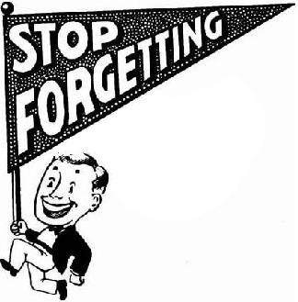
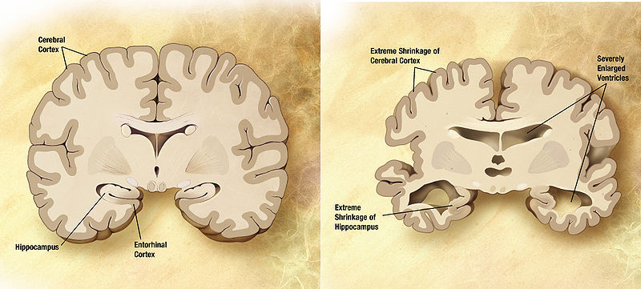
Topic: Forgetting and Dysfunctions of Memory
Aim: For what reasons can memory be dysfunctional
Do Now: What does it mean to forget something? Why do you think we forget things?

Slide 28

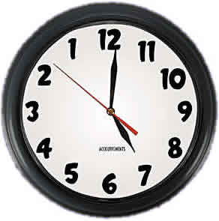
Why we Forget
Forgetting is necessary, and hardwired to our brain! Reasons can include:
Ineffective encoding: Information may never have been inserted into memory in the first place! This is usually due to lack of attention.
Decay: Memory fades with time!
Interference: People forget information because of competition from other material.

Slide 29

Why we Forget:
Motivated Forgetting/Repression: When people keep distressing thoughts and feelings buried in the unconscious mind. Trauma can suppress these memories
While many cases of recovered memories are authentic, evidence suggests that therapists can unknowingly create false memories in their patients.

Slide 30
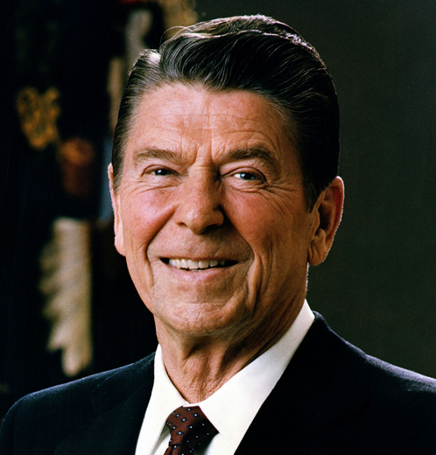
Demential/Alzheimer’s Disease:
Dementia: is a serious loss of cognitive ability in a previously unimpaired person. , may be the result of a unique brain injury, or disease such as…
Alzheimer’s Disease: Most common form of dementia. Typically diagnosed after 65. Symptoms can include confusion, irritability and aggression, mood swings, trouble with language, and long-term memory loss.
Former President Ronald Reagan died of Alzheimer’s in 2004

Slide 32
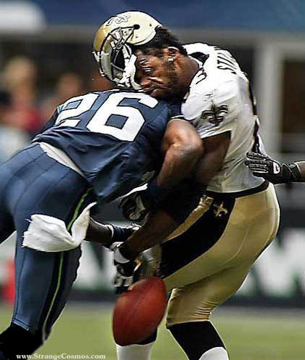
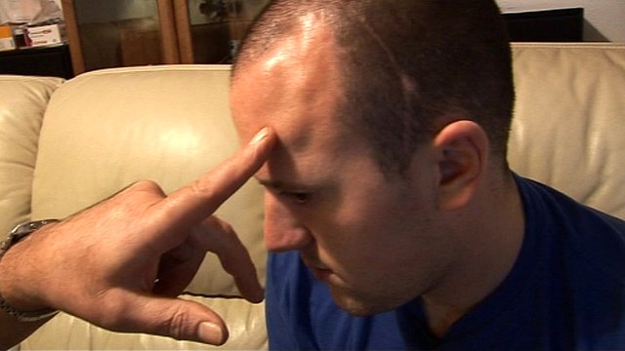

Slide 33
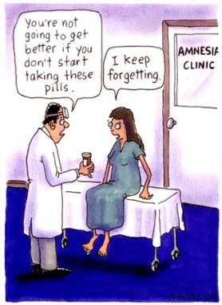
Memory Dysfunctions - Amnesia
Amnesia: Memory is lost in some way -can be either temporary or long term
Causes include: trauma, disease, or drugs.
It can be used as a defense mechanism to protect the brain

Slide 34

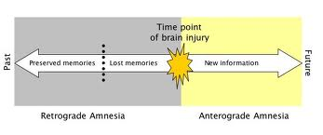
Types of Amnesia:
Anterograde: Can’t form new memories due to head trauma – info doesn’t move from short to long term memory
Retrograde: Loss of pre-existing memories
Lacunar: loss of memory of a specific event
Childhood: common inability to remember events from childhood

Slide 35
Other Types:
Source amnesia: you recall information, but not where you got it (Who told me that?)
Blackout amnesia: caused with short-term alcohol consumption
Prosopamnesia: inability to remember faces

Slide 36

Dissociative Amnesia
Dissociative Fugue State: An "inability to recall one's past and assumption of a new identity”
Occurs after traumatic event such as surviving a natural disaster, witnessing violent crime
Can last less than one month up to decades
People can switch between their fugue state identity and their pre-fugue state identity, causing confusion.

Slide 37
“Last year a Westchester County lawyer – a 57-year-old husband and father of two, Boy Scout leader and churchgoer – left the garage near his office and disappeared. Six months later he was found living under a new name in a homeless shelter in Chicago, not knowing who he was or where he came from. Library searches and contact with the Chicago police did not help the man. His true identity was uncovered through an anonymous tip to “America’s Most Wanted.” But when he was contacted by his family, he had no idea who they were.”
---New York Times

Slide 38
Déjà Vu
Déjà vu describes the experience of feeling that one has witnessed or experienced a new situation previously.
The experience of déjà vu is usually accompanied by a compelling sense of familiarity
Usually attributed to a dream

Slide 39
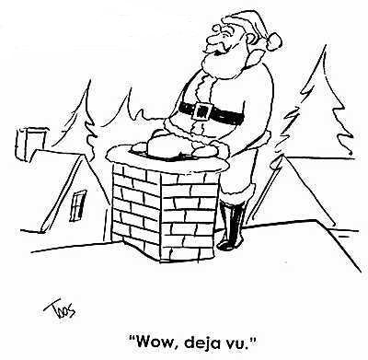
Déjà Vu
It may result from an overlap between the neurological systems responsible for short-term memory (events which are perceived as being in the present) and those responsible for long-term memory (events which are perceived as being in the past).

